Slide 1

Computer Graphics: Rendering
CS 498VR: Virtual Reality
UNIVERSITY OF ILLINOIS AT URBANA-CHAMPAIGN
Eric Shaffer

Slide 2
Computer Graphics
We have just finished looking at human perception of light and color
How do computer graphics systems simulate light transport?
We have seen how geometry is transformed

Slide 3
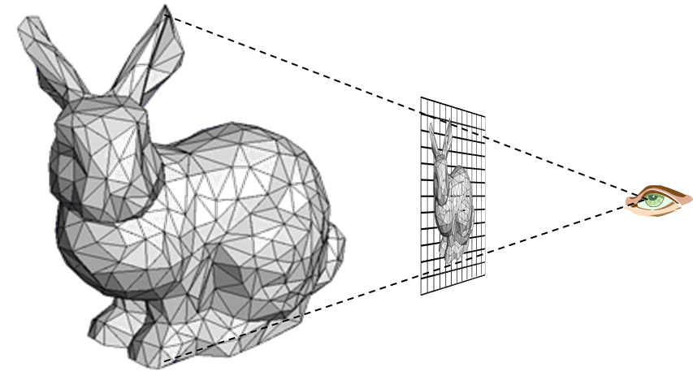
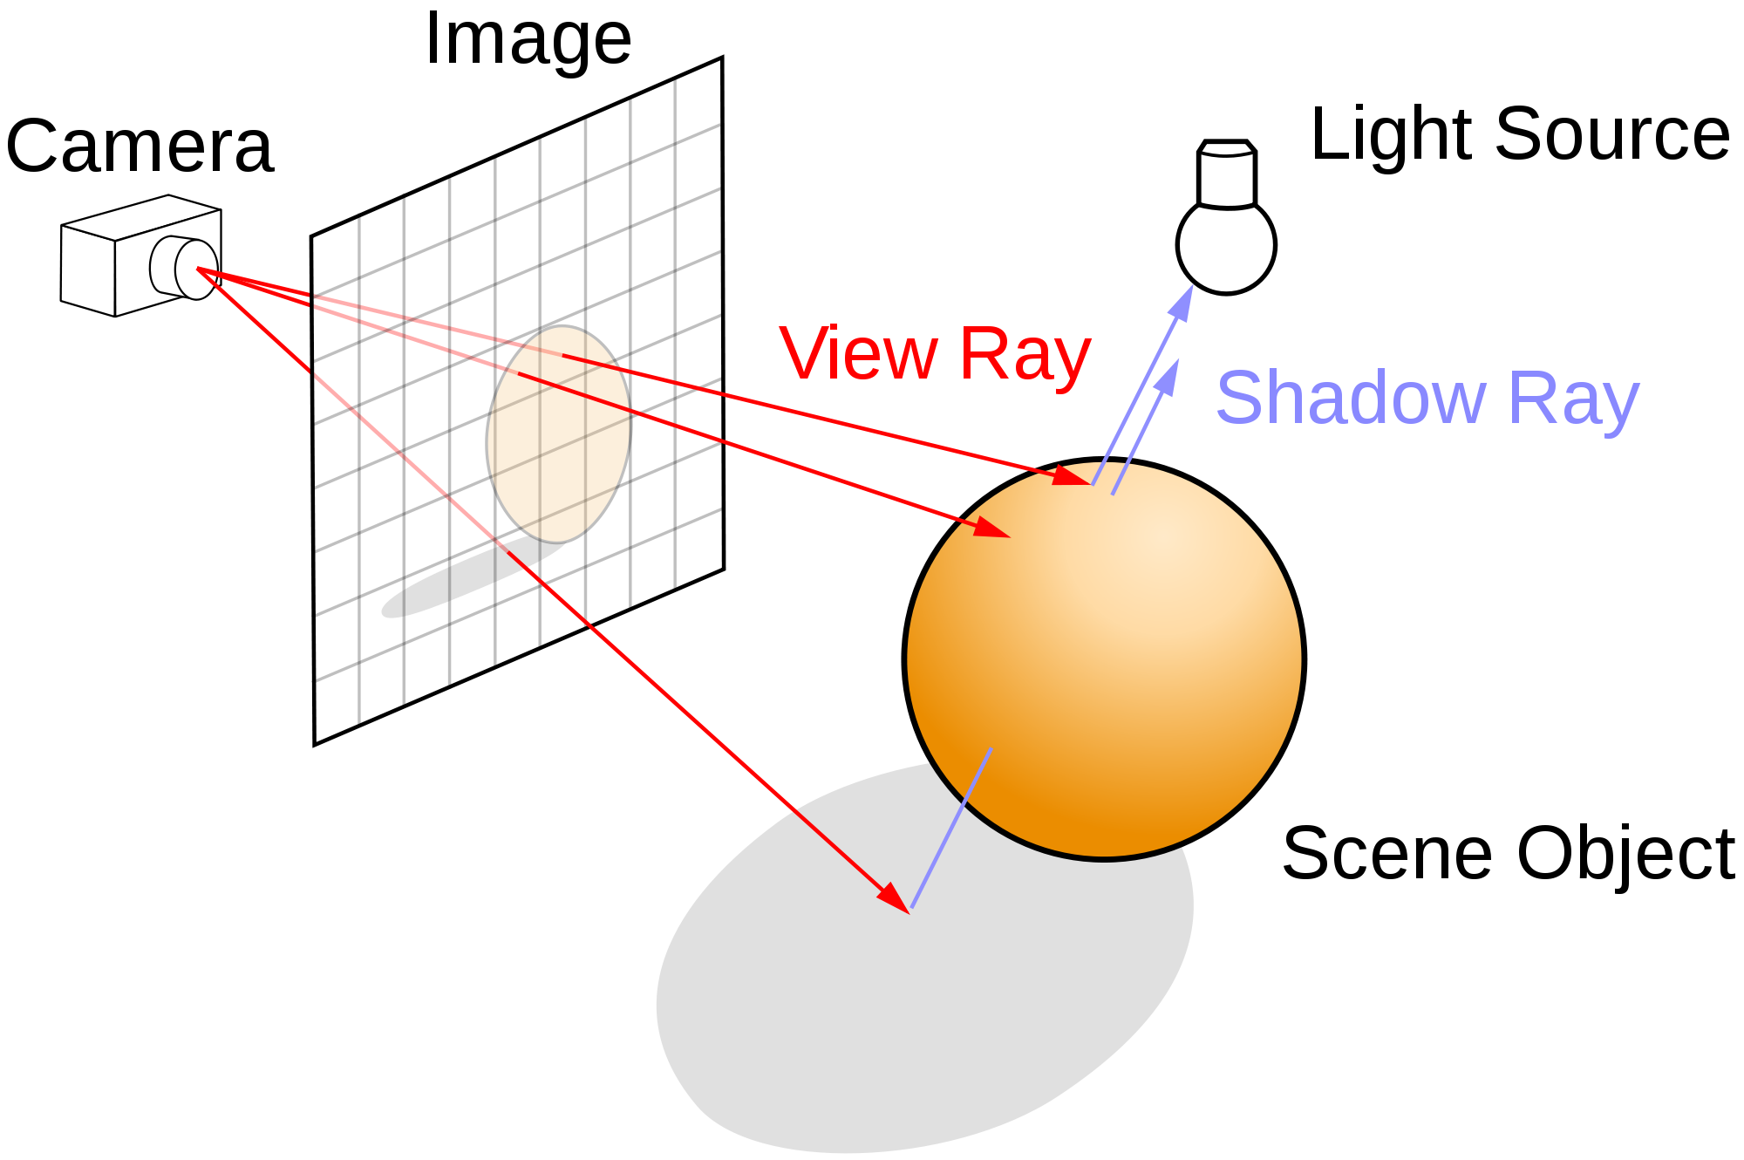
Rasterization versus Ray Tracing
To oversimplify….
In rasterization, geometric primitives are projected onto an image plane and the rasterizer figures out which pixels get filled.
In ray-tracing, we model the physical transport of light by shooting a sampling ray though each pixel in an image plane and seeing what the ray hits in the scene

Slide 4
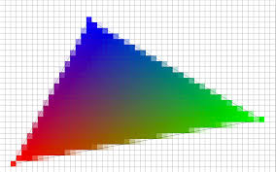
Rendering: Rasterization
We project the 3D geometry to 2D
Compute which pixels are covered
Not complicated…but we’ll skip the details
Compute colors for the vertices
Fill interior of the projected polygons
Blend the vertex colors: interpolation

Slide 5
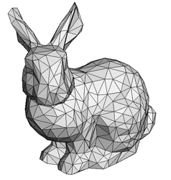


Rasterization: 3D Graphics Pipeline
Vertex Processing
Rasterization
Fragment Processing
Fragments Are like pixels…but they aren’t necessarily the finalized pixels you see in an image.
Each fragment has a 2D location in a raster and a color. Final pixel value is typically found by applying hidden surface removal and possibly compositing to a set of fragments.

Slide 6
Interpolating Colors: Barycentric Coordinates
Describe location of point in a triangle in relation to the vertices
p=(λ₁,λ₂ ,λ₃) where the following are true
p=λ₁a + λ₂ b +λ₃c
λ₁+λ₂ +λ₃= 1
To interpolate a color f(v) sampled at the vertices we just do:
f(p)=λ₁f(a) + λ₂ f(b) +λ₃f(c)
a
p
b
c

Slide 7
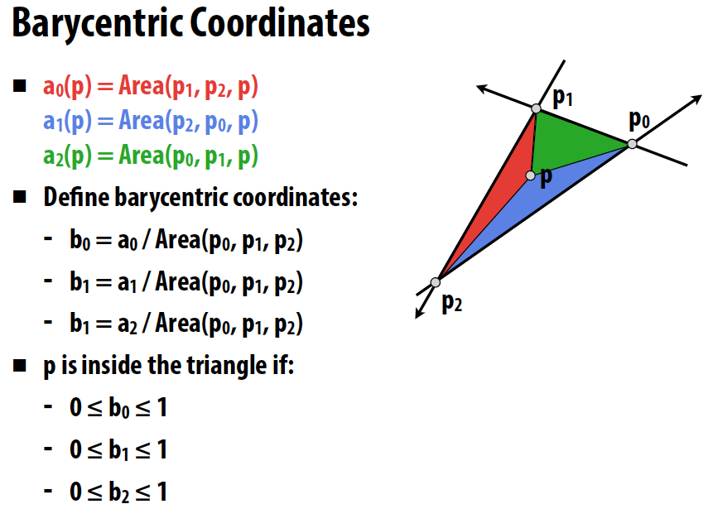
Barycentric Coordinates
should be b2 →
Image from Stanford’s CS348b: Image Synthesis by Matt Pharr
Barycentric coordinates express the location of a point p as a linear combination of the coordinates of 3 vertices
P = (b0,b1,b2)
Notes:
Can you implement a ray-triangle intersection test?

Slide 8

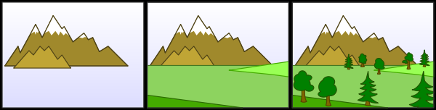
Hidden Surface Removal
We need for objects occluded by other objects to not be seen
Painters Algorithm
First method proposed for doing hidden surface removal
Sort triangles by depth
Draw the triangles into the frame buffer in sorted order
Farthest to closest
…so closer objects are drawn over farther objects
What are some problems with this?

Slide 9
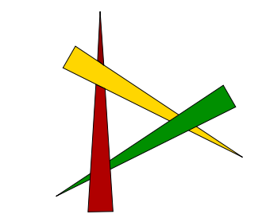
Painter’s Algorithm
It’s expensive to sort….
Also, a single triangle can have multiple depths
Occlusion cycles cannot be resolved

Slide 10
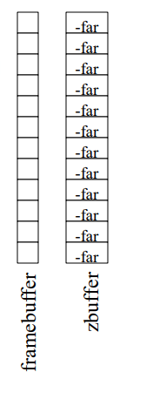
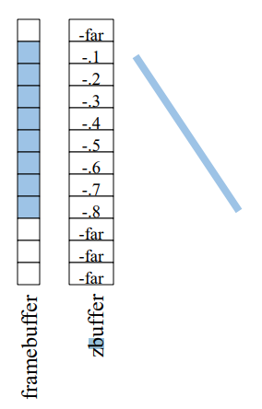
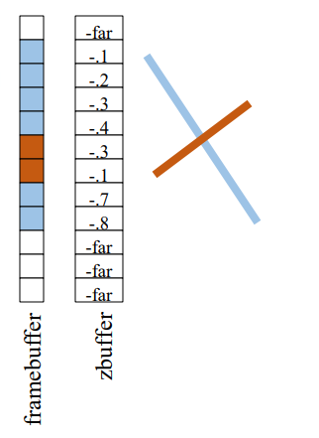
Hidden Surface Removal: Z-Buffer
In addition to the frame-buffer that stores pixel colors
Keep a Z-Buffer that stores pixel depth
For each fragment (x,y) we process check if it is closer than frame-buffer pixel
If so, update frame-buffer and Z-Buffer values

Slide 11
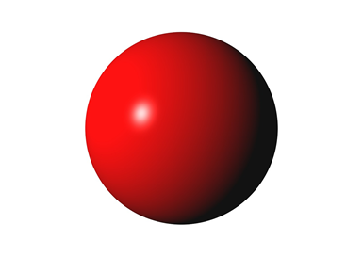

Shading
Shading refers to the process of determining the color for a pixel (or vertex…or polygon) during the rendering process
If we draw sphere using the same red for each pixel…we get something that is not realistic
We need to model how light is reflected from the surface in the real world….
The most common model is the Phong Repflection model
Created 40 years ago…still widely used
Though more physically correct reflection models are starting to be used more

Slide 12
Why we need shading
Suppose we build a model of a sphere using many polygons. We color it with a single color as we have done so far. We get something like
But we want

Slide 13
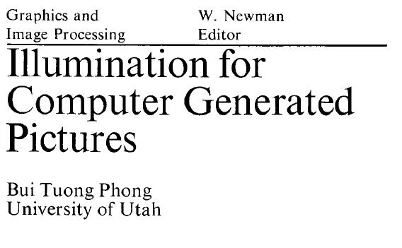
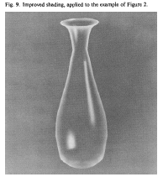
Bui Tuong Phong
December 14, 1942 – July 1975
Born in Hanoi
Earned his PhD in 2 years at the University of Utah (1973)
Worked with Professor Ivan Sutherland
Dissertation work was the Phong reflectance model
Also produced model and realistic image of a VW bug

Slide 14
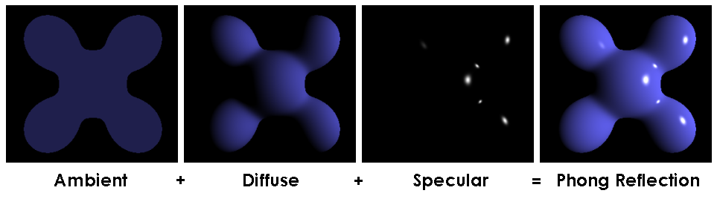
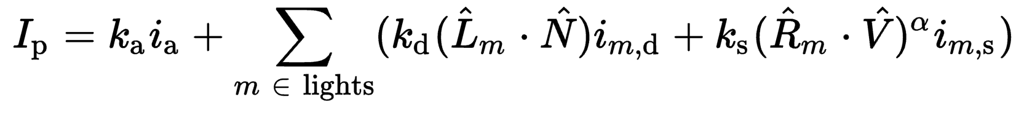
Phong Reflectance Model

Slide 15

Shading
Why does the image of a real sphere look like
Light-material interactions cause each point to have a different color or shade
Need to consider
Light sources
Material properties
Location of viewer
Surface orientation

Slide 16
Shading
Well…there’s a lot of symbols but the ideas and math are simple
We will create a simple mathematical model for shading
It will be function that takes in:
Light sources
Material properties
Location of viewer
Surface orientation
And returns a color….

Slide 17
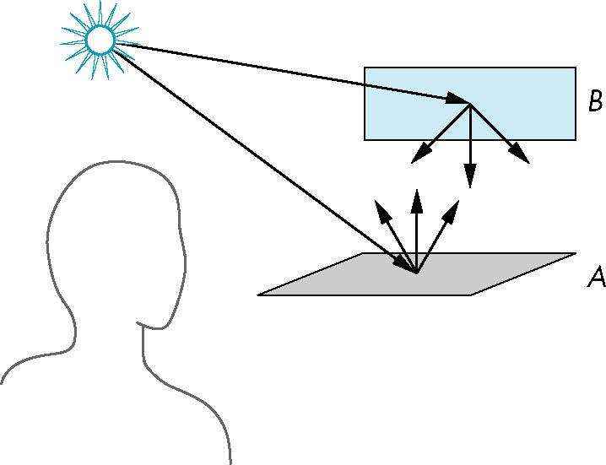
Scattering
Light strikes A
Some scattered
Some absorbed
Some of scattered light strikes B
Some scattered
Some absorbed
Some of this scattered light strikes A and so on

Slide 18
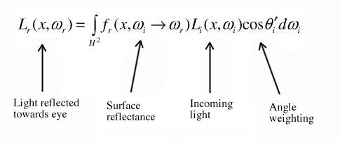
Rendering Equation
Scattering and absorption of light described by the rendering equation
Scattering and absorption are infinite phenomena
Cannot be solved in general analytically
Describes global lighting effects
CS 419 discusses solutions to the rendering equation
Ray-tracing, path tracing, etc.

Slide 19
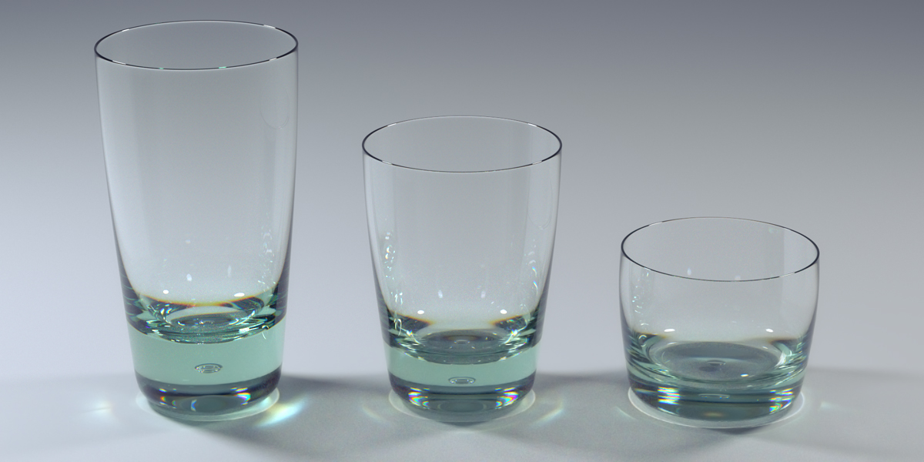
Global Effects

Slide 20
Local vs Global Illumination
Correct shading requires a global calculation involving all objects and light sources
Incompatible with pipeline model which shades each polygon independently
Why do we want to shade each polygon independently?
However, in computer graphics, we are happy if things “look right”
There exist many techniques for approximating global effects
Can anyone guess what you can do to approximate global illumination in rasterization?
How do people render shadows? Or mirrors?

Slide 21
Light-Material Interaction
Light that strikes an object is
partially absorbed and
partially scattered (reflected)
The amount reflected determines
color of the object
brightness of the object
A surface appears red under white light because the red component of the light is reflected
How the reflected light is scattered depends on
the smoothness and orientation of the surface

Slide 22
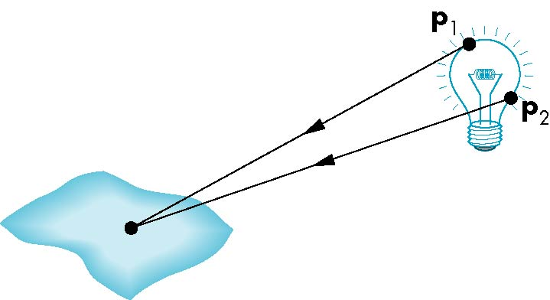
Light Sources
General light sources are complex to model
Would need to integrate light coming from all points on the source

Slide 23
Simple Light Source Models
Point source
Model with position and color
Directional source
Distant source = infinite distance away (parallel)
Ambient light
Same amount of light everywhere in scene
Can model contribution of many sources and reflecting surfaces

Slide 24

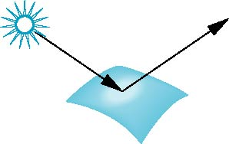
Surface Types
Consider light traveling along a specific ray
The smoother a surface, the more reflected light is concentrated in a single direction
Perfect mirror reflects perfectly in a single direction
A very rough surface scatters light in all directions
smooth surface
rough surface

Slide 25
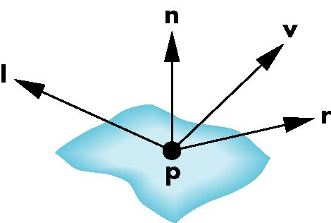
The Phong Reflection Model
A simple model that can be computed rapidly
Has three components
Diffuse
Specular
Ambient
Uses four vectors
To source
To viewer
Normal
Perfect reflector

Slide 26
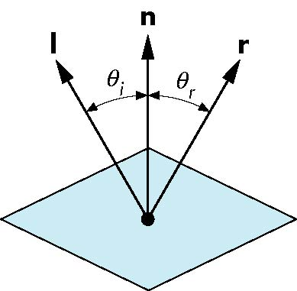
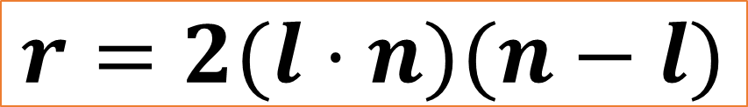
Modeling a Ideal Reflector – Specular Reflection
Incoming light ray is reflected in a single
Normal is determined by local orientation
Given the direction of incoming light…we can find r
l and n are unit vectors
Angle of incidence = angle of reflection
The three vectors will be coplanar
What is another name for an ideal reflector?
r is computed as
$$r=2(l⋅n)(n−l)$$

Slide 27
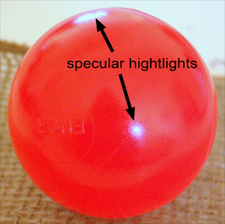
Specular Reflection
Perfect specular reflection
Light is reflected in the single direction r
…the mirror reflection direction
Glossy specular reflection
Scattering clustered around mirror reflection direction

Slide 28
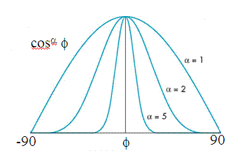
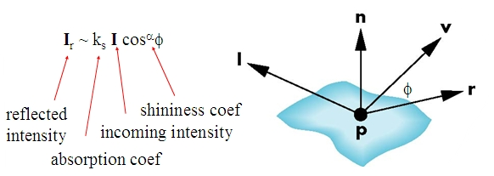

Specular Reflection
Reflectance determined by
Alignment of view vector with mirror reflection vector
Shininess coefficient
High coefficient means smoother look
Maybe 100 for metal…maybe 10 for plastic

Slide 29
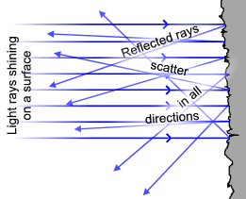
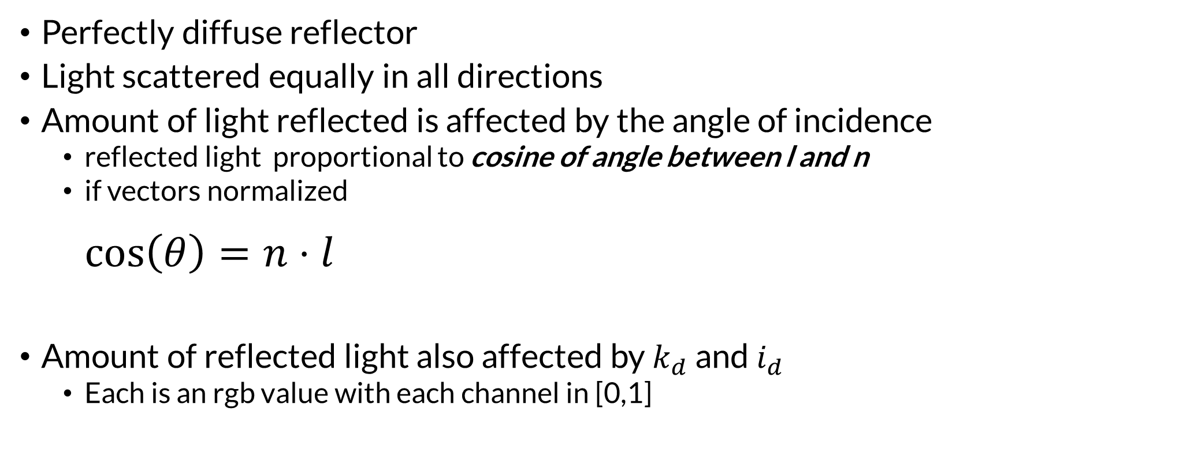
Modeling a Lambertian Surface – Diffuse Reflection
Perfectly diffuse reflector
Light scattered equally in all directions
Amount of light reflected is affected by the angle of incidence
reflected light proportional to cosine of angle between l and n
if vectors normalized $\cos\left(θ\right)=n⋅l$
Amount of reflected light also affected by $k_{d}$ and $i_{d}$
Each is an rgb value with each channel in [0,1]

Slide 30
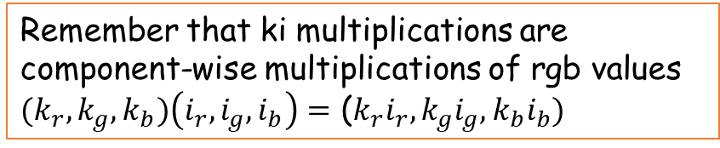
Ambient Light
Result of multiple interactions between light sources and surfaces
Amount and color depend on the color of the light(s) and the material properties
Add k_{a} I_{a} to diffuse and specular terms
Remember that ki multiplications are component-wise multiplications of rgb values
${(k}_{r},k_{g},k_{b})\left(i_{r},i_{g},i_{b}\right)=$ (${k_{r}i}_{r},k_{g}i_{g},k_{b}i_{b})$

Slide 31
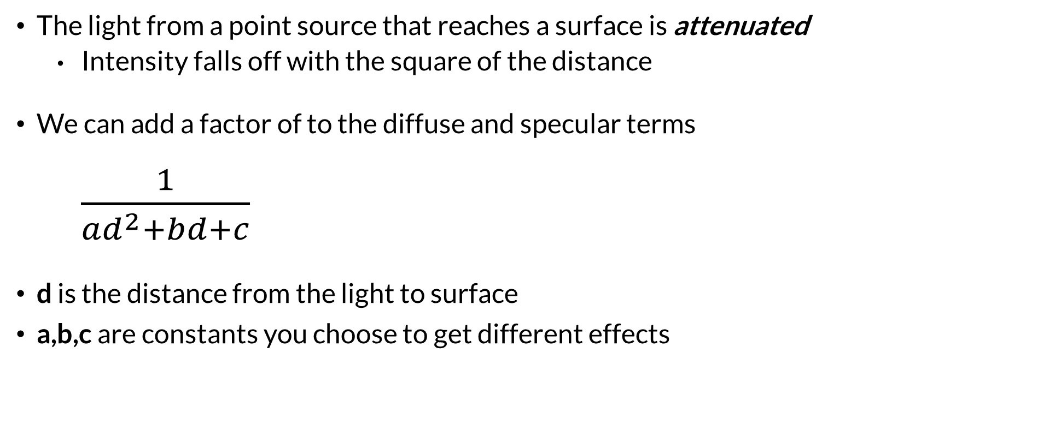
Distance Terms
The light from a point source that reaches a surface is attenuated
Intensity falls off with the square of the distance
We can add a factor of to the diffuse and specular terms $\frac{1}{{ad}^{2}+bd+c}$
d is the distance from the light to surface
a,b,c are constants you choose to get different effects

Slide 32

Light Sources
In the Phong Model, we add the results from each light source
Each light source has separate terms for
diffuse
specular
ambient terms
This form does not have a physical justification
Separate red, green and blue components
Hence, 9 coefficients for each point source
I_{dr}, I_{dg}, I_{db}, I_{sr}, I_{sg}, I_{sb}, I_{ar}, I_{ag}, I_{ab}

Slide 33
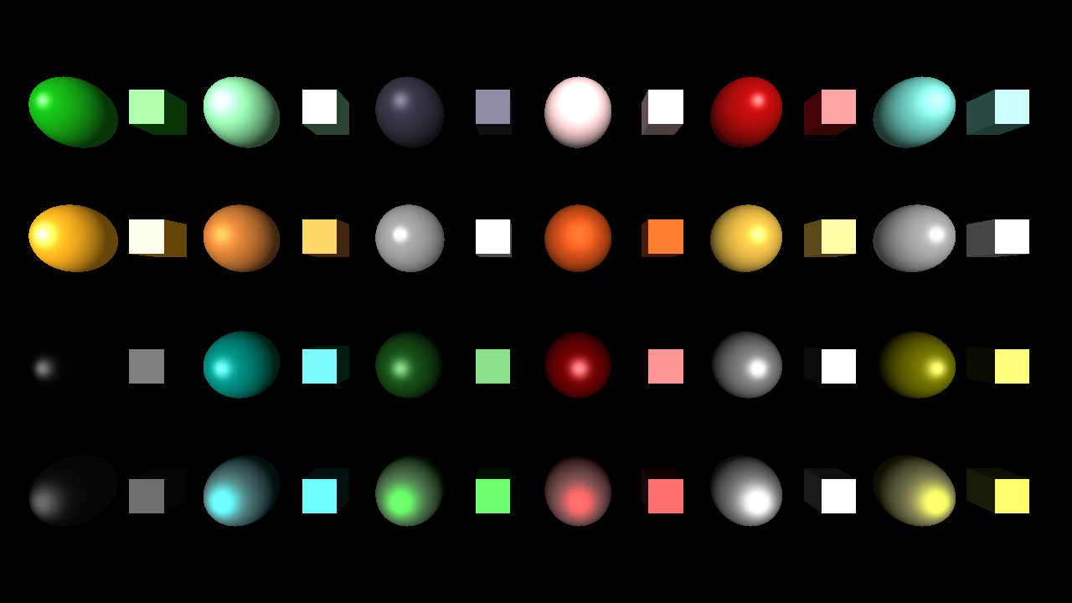

Material Properties
Material properties match light source properties
Nine reflection coefficients
k_{dr}, k_{dg}, k_{db}, k_{sr}, k_{sg}, k_{sb}, k_{ar}, k_{ag}, k_{ab}
These vary from 0 to 1
Materials also have shininess coefficient $α$

Slide 34
Phong Reflectance Model
Summing over all the light sources, the Phong model can be written as

Slide 35
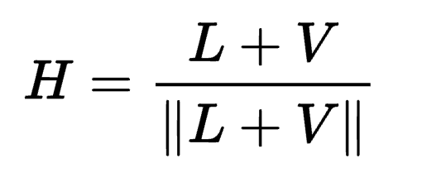
Blinn-Phong Reflectance Model
Jim Blinn suggested an approximating changing specular term
Replace (V · R )ª by (N · H )^{b} where
“Halfway vector”
More efficient in terms of the operations used
Closer to physically correct lighting
Pick exponent b to match what you want
Using higher b>a will make output similar to Phong with a

Slide 36
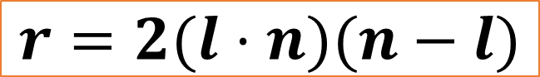
The Halfway Vector
H is normalized vector halfway between L and V
$$r=2(l⋅n)(n−l)$$

Slide 37
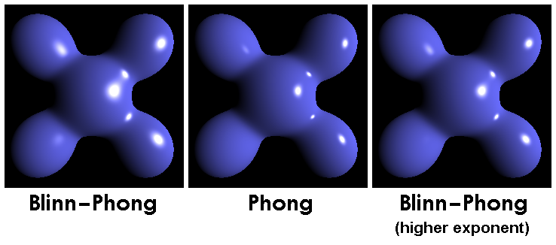
Phong versus Blinn-Phong

Slide 38
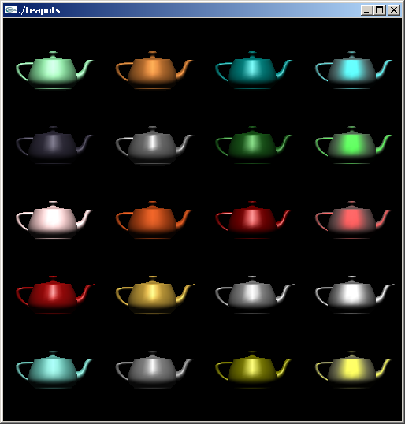
Example
Only differences in
these teapots are
the parameters
in the modified
Phong model

Slide 39
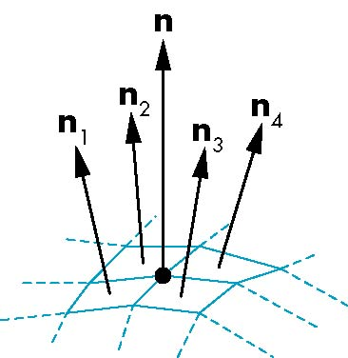
Mesh Shading
To shade a vertex we need a surface normal at that vertex
For polygonal meshes, Henri Gouraud proposed we
use the average of the normals around a vertex
n = (n₁+n₂+n₃+n₄)/ |n₁+n₂+n₃+n₄|

Slide 40
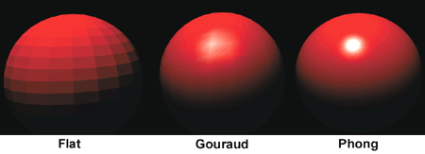
Gouraud and Phong Shading
Gouraud Shading
Find average normal at each vertex
Apply Blinn-Phong model at each vertex
Interpolate vertex shades across each polygon
Phong shading
Find average normal at each vertex
Interpolate vertex normals across edges
Interpolate edge normals across polygon
Apply Blinn-Phong model at each fragment

Slide 41
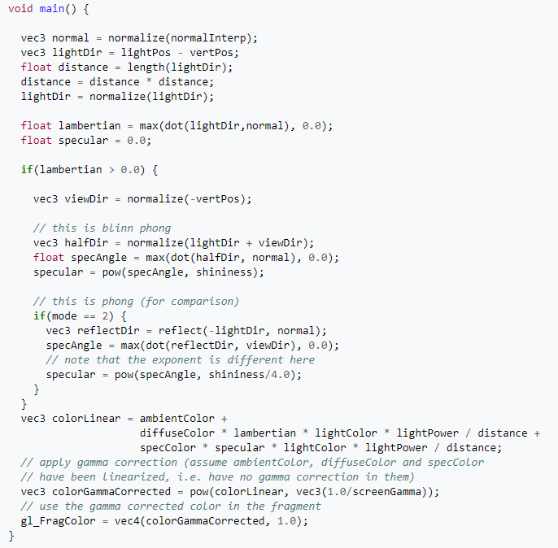
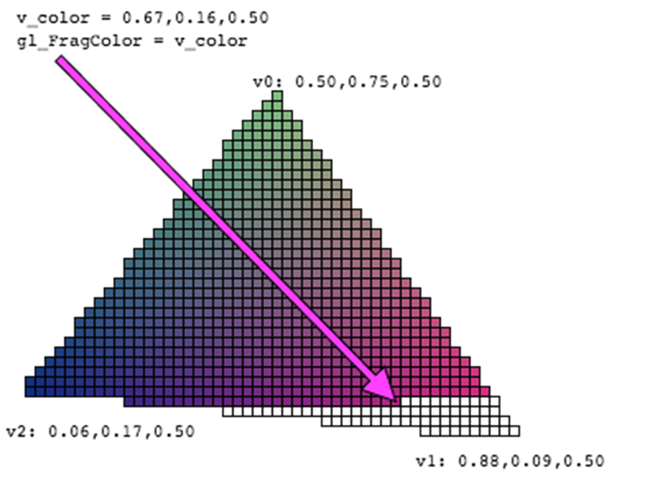
Shaders
In modern rendering systems, colors are computed by shader programs
These shader programs run on the GPU

Slide 42
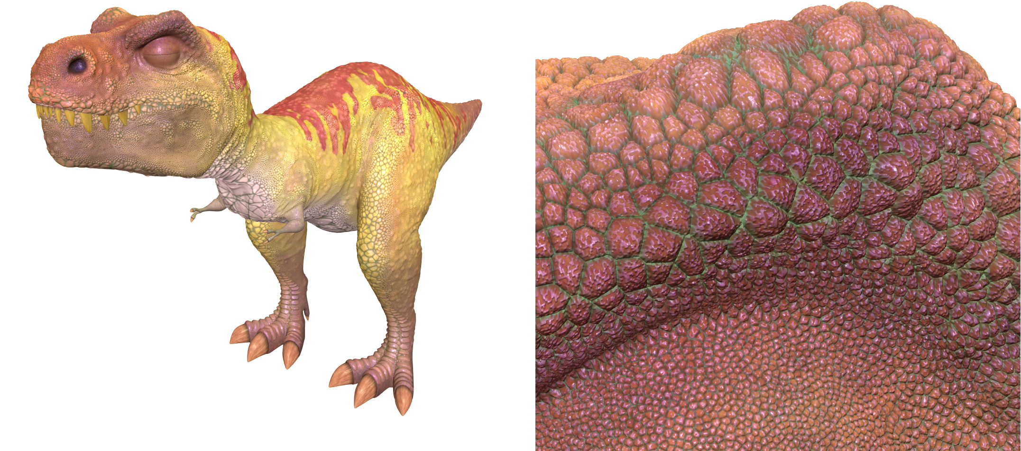
The Limits of Geometric Modeling
Graphics cards can render over 10 billion polygons per second
That number is still insufficient for many visual phenomena
Consider rendering a herd of bumpy-skinned dinosaurs

Slide 43
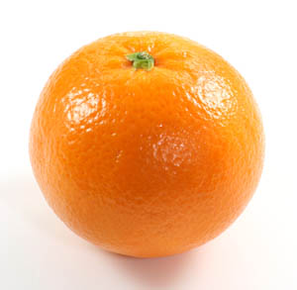
Or Consider Modeling an Orange
Consider the problem of modeling an orange
Start with an orange-colored sphere
Too simple
Replace sphere with a more complex shape
Does not capture surface characteristics (small dimples)
Takes too many polygons to model all the dimples

Slide 44
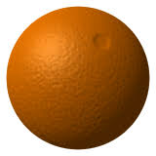
Modeling an Orange
Take a picture of a real orange
“paste” pixels of the image onto simple geometric model
This process is known as texture mapping
Still might be problematic…
Looking at the orange in a rendered scene
How could you tell the colors on the orange aren’t generated by shading?

Slide 45
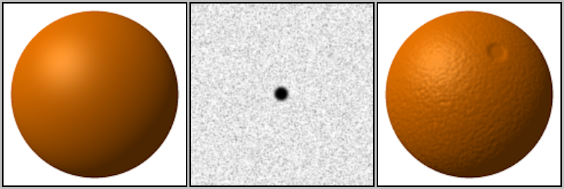
Modeling an Orange
Another alternative would be bump mapping
Use an image that specifies the normal to use to render the surface
This way, can render an “bumpy” surface during shading
Without modeling the bumpy surface with lots of triangles

Slide 46
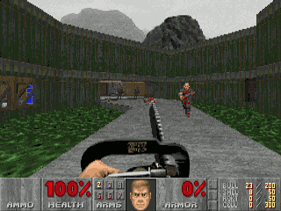
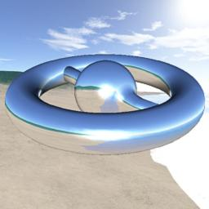
Three Types of Mapping
Texture Mapping
Uses images to fill inside of polygons
Environment Mapping
Uses a picture of the environment for texture maps
Allows simulation of mirror-like surfaces
Bump mapping
Alters normal vectors during the rendering process
Generates a bumpy looking surface

Slide 47
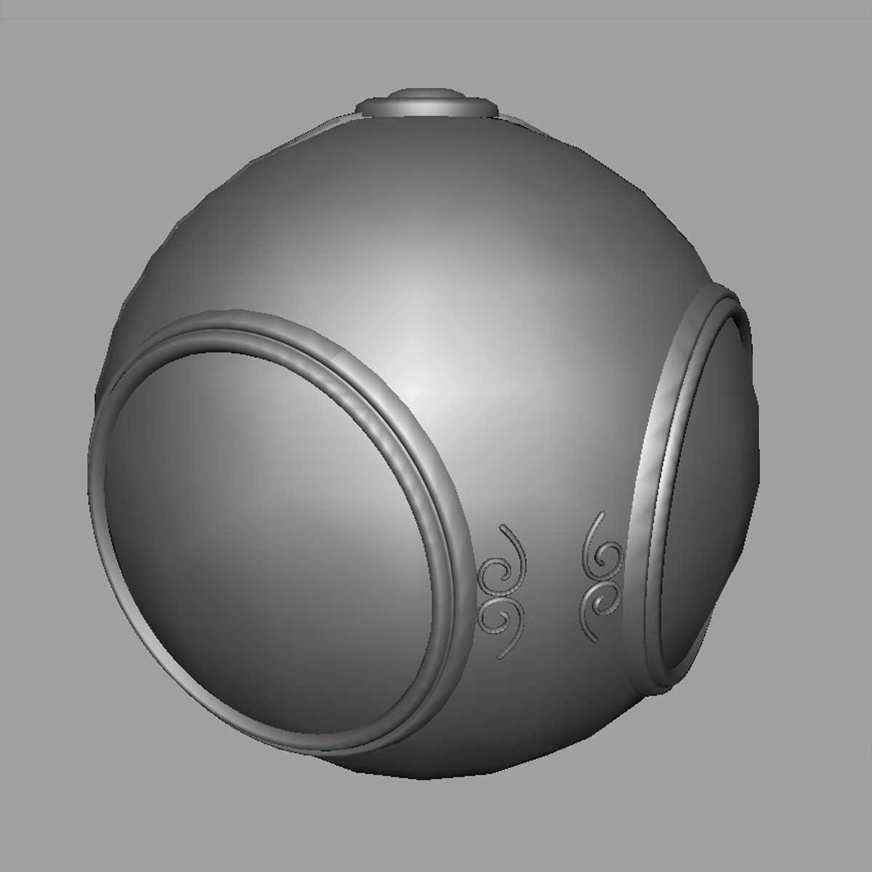
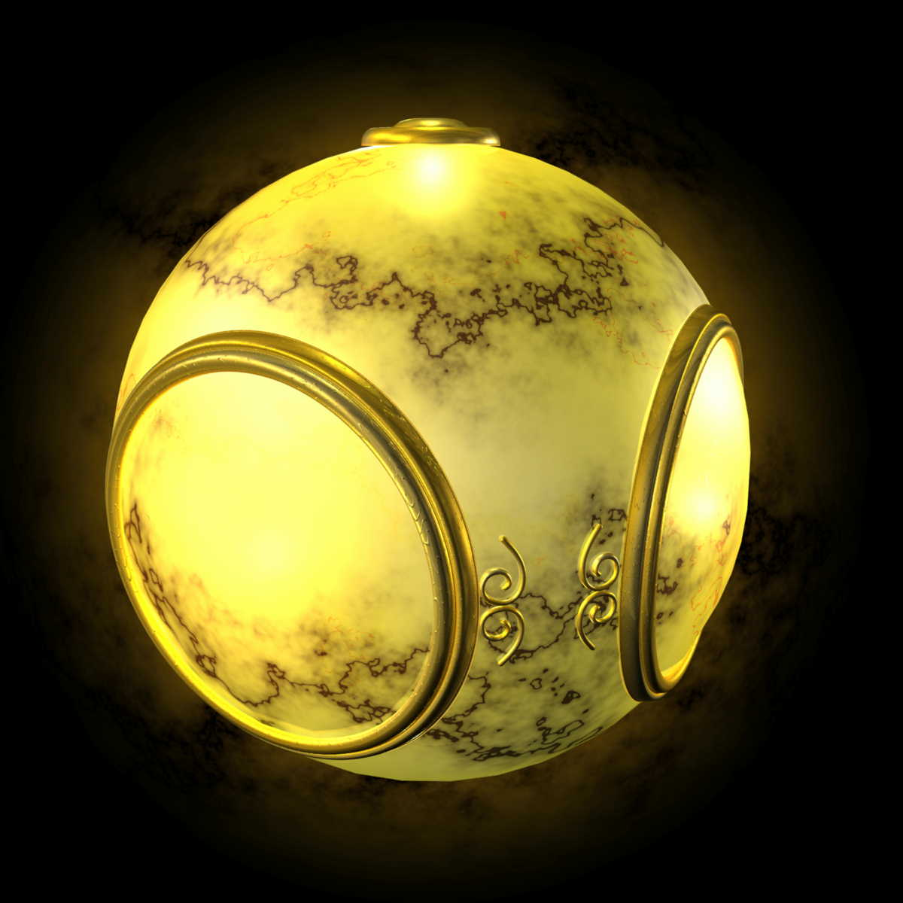
Texture Mapping
geometric model
texture mapped

Slide 48
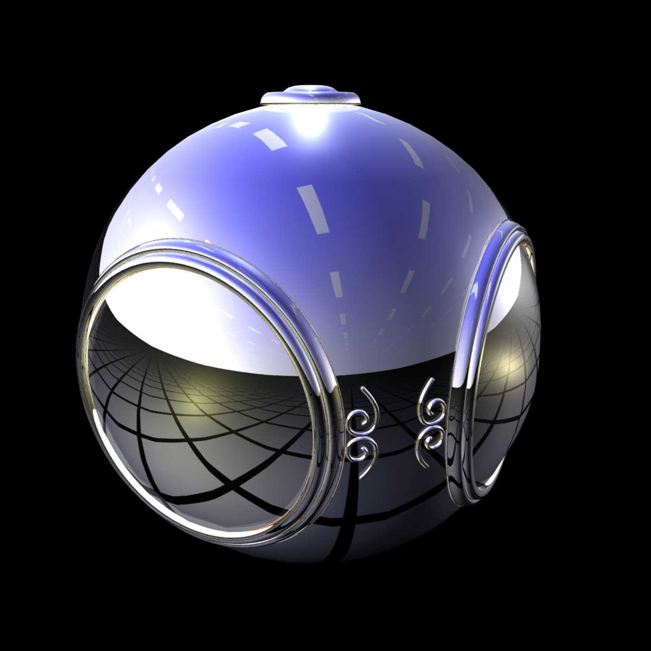
Environment Mapping

Slide 49
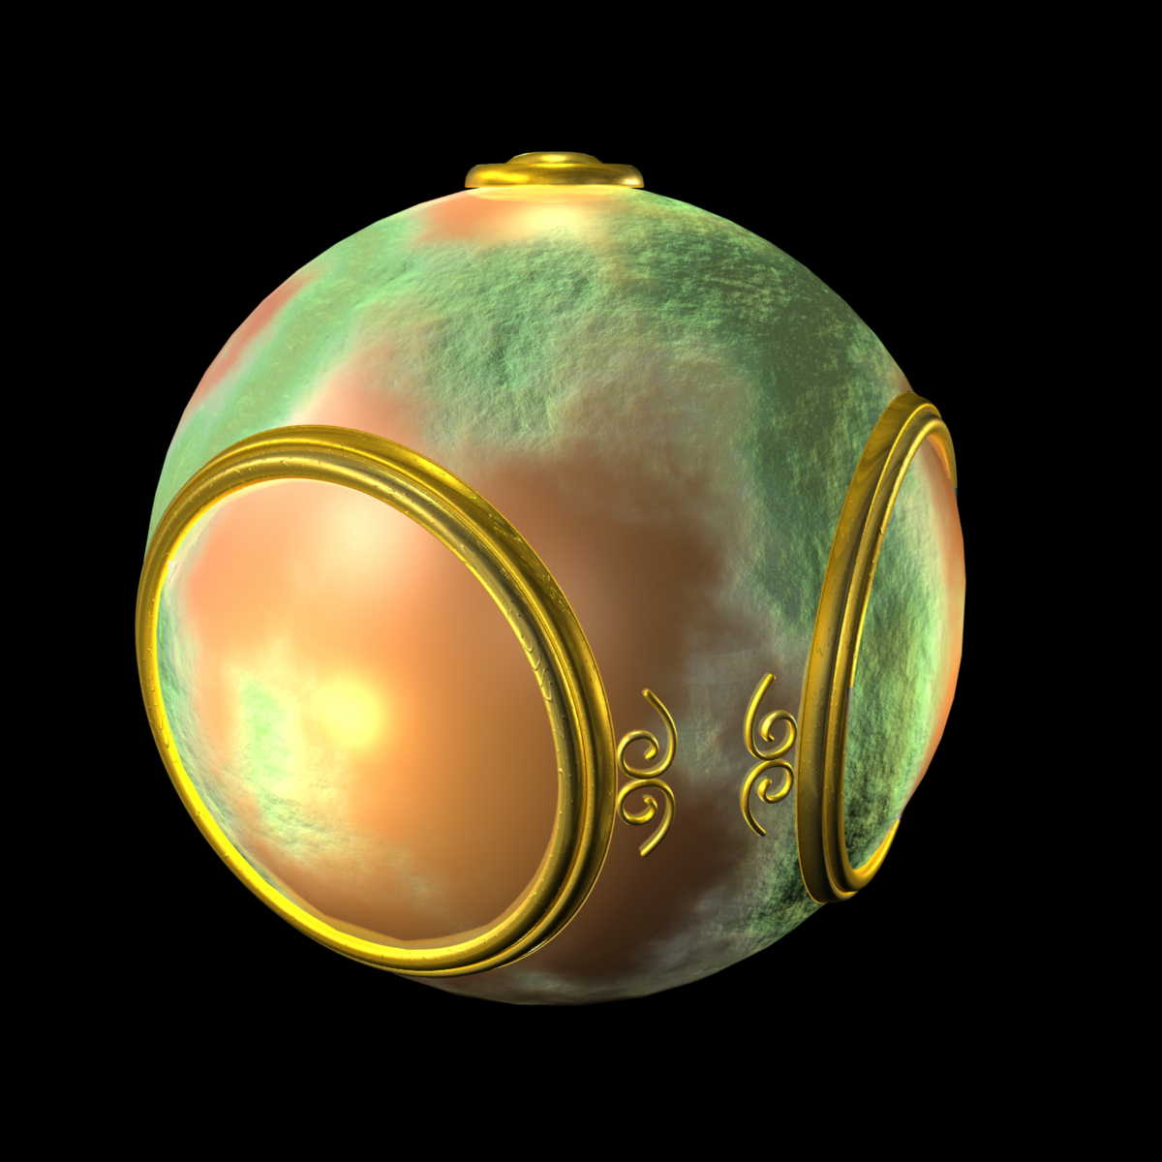
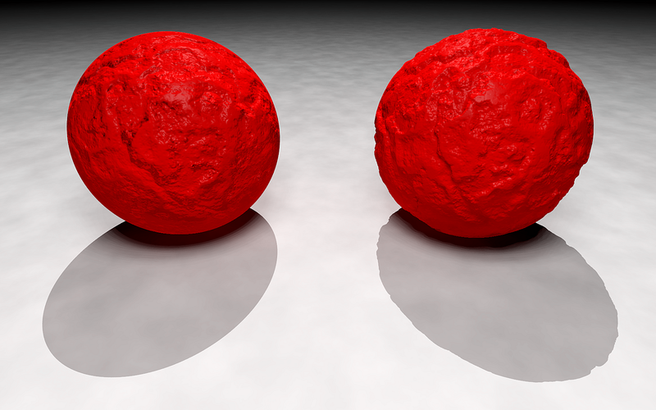
Bump (or Normal) Mapping

Slide 50

The Idea is Simple
Map an image to a surface
Each fragment samples a color from the image
2D image
3D surface

Slide 51
Specifying a Texture Mapping Function
You need to come up with a mapping from surface vertices → texture space
Specify mapping using (u,v) vertex attributes
The (u,v) coordinates map into a parametric texture space
Generally (u,v) is in [0,1] x [0, 1]
We can allow coordinates to go outside that range...
if we tell WebGL how to handle that event …more on that later

Slide 52
Mapping a Texture
Based on parametric texture coordinates
Specify as a 2D vertex attribute
Texture Space
Object Space
v
1, 1
(u, v) = (0.2, 0.8)
0, 1
A
a
c
(0.4, 0.2)
b
B
C
0, 0
1, 0
u
(0.8, 0.4)

Slide 53

Mapping a Texture
Can be distortions
texture stretched
over trapezoid
showing effects of
bilinear interpolation
good selection
of tex coordinates
poor selection
of tex coordinates

Slide 54
Texture Filtering
We often have a mismatch between texture size and number of fragments
Requires us to adjust how the texture is sampled…
This more complicated sampling process is called texture filtering
Magnification occurs when we have more fragments than texels
Minification occurs when we have more texels than fragments
Two common mag filters
Nearest Neighbor
Bilinear
Most common min filter
Mipmapping

Slide 55

Magnification Examples

Slide 56
Mipmapping
Mipmapping is a method of pre-filtering a texture for minification
mip = “multum in parvo”…. latin: many things in small place(?)
We generate a pyramid of textures
Bottom-level is the original texture
Each subsequent level reduces the resolution by ¼

Slide 57
Sprites versus Textures
Where do you see sprites being used?
Where do you see textures being used?
What is the difference?

Slide 58

Bump Mapping and Normal Mapping
Bump Mapping:
Perturbing mesh normals to create the appearance of geometric detail
Normal Mapping:
A way of implementing bump mapping

Slide 59


Bump Mapping and Shading

Slide 60

Environment Mapping
How can we render reflections with a rasterization engine?
When shading a fragment, usually don’t know other scene geometry
Answer: use texture mapping….
Create a texture of the environment
Map it onto mirror object surface

Slide 61

Types of Environment Maps

Slide 62

Cube Map
Cube mapping takes a different approach….
Imagine an object is in a box…and you can see the environment through that box

Slide 63

Forming a Cube Map
A cube map requires 6 images
Each covers a 90 degree angle from the center of the cube

Slide 64

Index using the Reflection Vector

Slide 65
Ray Tracing
Follow ray of light….
Can trace from an eyepoint through a pixel
See what object the ray hits…
Compute the color of the light being reflected from the hit point.

Slide 66
Ray Tracing: Extremely Flexible
Can simulate global visual effects such as
Mirror-like reflection
Transparency and translucency
Global illumination (indirect lighting and color bleeding)
Soft shadows….
And mores……

Slide 70


Ray-Tracing: Computationally Intense
LOTS of rays get generated
Each pixel requires multiple primary rays for anti-aliasing
Each hit on a surface recursively generates more rays
Cornell Box About 100,000 rays per pixel

Slide 71
Real-Time Ray-Tracing

Slide 72

NVIDIA RTX: Real-Time Ray-Tracing Demo

